Slide 1

CONVERSATIONAL RESEARCH · POWERED BY WHATSAPP
WHAT IS YAZI
Research and customer feedback that people actually reply to — over WhatsApp.
Yazi runs surveys, AI interviews and diary studies inside WhatsApp, on a panel of 1.8M+ pre-qualified respondents across 20+ countries. Conversational, multilingual, and live in hours — not weeks.
askyazi.com

Slide 2






WHY IT WORKS
WhatsApp delivery beats every other channel.
68%+
<2 hrs
$0.50
150+
Response rate — ~5× higher than email
Average time to complete vs 3–5 days
Cost per complete vs $15–25 traditional
Languages with built-in translation
Trusted by KFC, Uber, Ipsos, Harvard Business School, Discovery & more

Slide 3
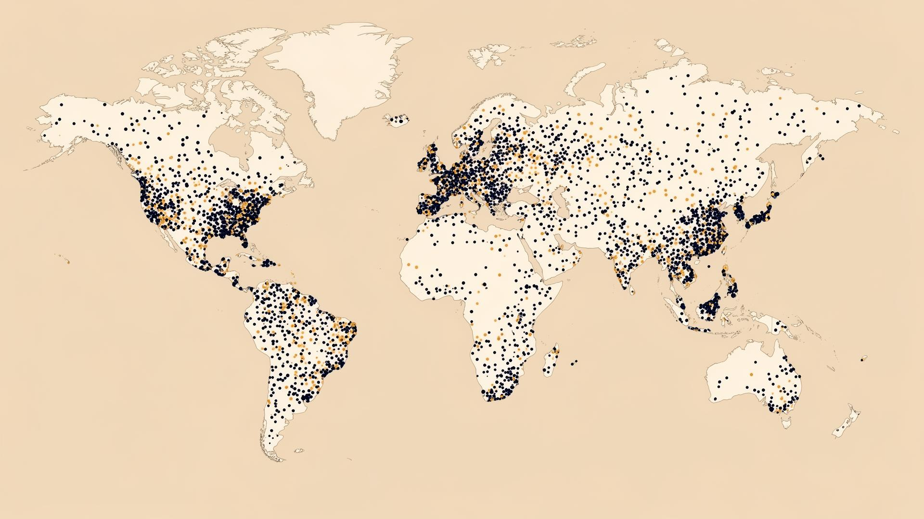
REACH & RECRUITMENT
A 1.8M+ panel, or your own database.
• 1.8M+ pre-qualified respondents across 20+ countries
• Partner network — Cint, Prolific, Respondent IO — reaching 50+ countries
• Or upload the client's own customer lists via CRM/API
• Profiled, verified, recruited at a fraction of traditional cost
askyazi.com

Slide 4
MARKET RESEARCH
WhatsApp-native research
Full-method research on a 1.8M+ panel — quant, qual and everything between.
Brand tracking, concept & pricing tests, ad testing, AI interviews and diary studies. Fielded conversationally over WhatsApp across 20+ countries, in 150+ languages.
askyazi.com

Slide 5
MARKET RESEARCH · HOW IT WORKS
From brief to fielded study in hours, not weeks.
A conversational field method that holds up to agency rigour.
1
2
3
4
Design
Recruit
Field
Analyse
AI-assisted scripting with skip logic, randomisation and adaptive follow-ups. Quant and qual in one flow.
Tap the 1.8M+ panel or upload the client's own database. Verified, profiled respondents across 20+ countries.
Respondents reply in WhatsApp — text, voice or video — in 150+ languages with live translation. PII auto-masked.
Real-time themes, cross-tabs and AI summaries. Export clean data straight into your reporting.
Van Westendorp · Gabor-Granger · concept & ad testing · brand tracking · AI interviews

Slide 6
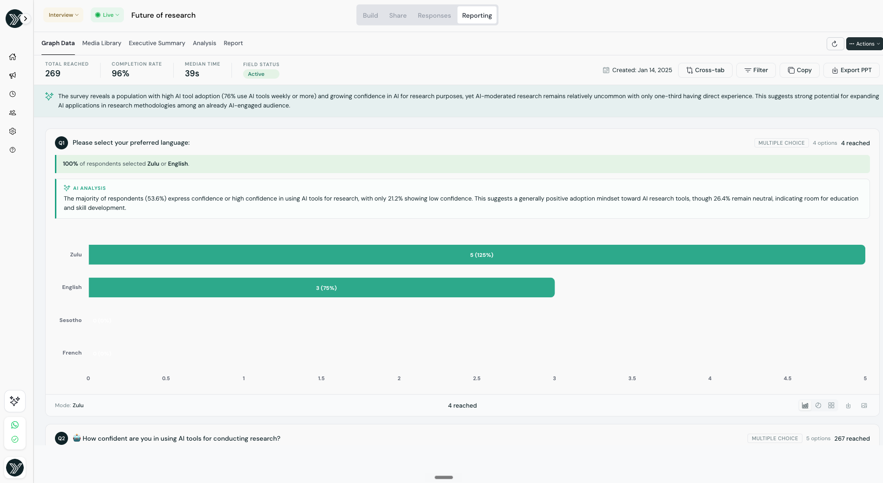
MARKET RESEARCH · OUTPUT
Live analytics, exportable to PowerPoint.
• Real-time completion, reach and median-time tracking as the study fields
• Interactive bar charts with filtering and cross-tab capabilities
• AI analysis surfaces the “so what” on every question
• One-click export straight to PowerPoint or your stats package
askyazi.com

Slide 7
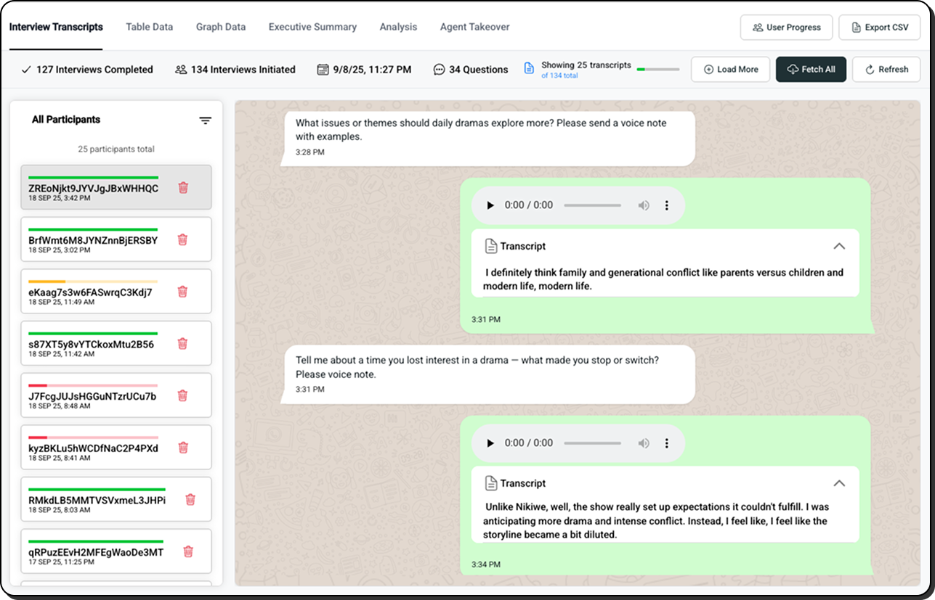
MARKET RESEARCH · QUALITATIVE
Qual depth, at survey-level scale.
• Immersive chat view — transcripts plus voice & video, with image meta-text
• Media gallery — browse and download every rich-media response
• Agent takeover — step in as a human moderator to probe in real time
• AI threads themes across every participant, in 150+ languages
askyazi.com

Slide 8
MARKET RESEARCH · WHY WHATSAPP
A better field method, on the numbers.
Metric | Traditional (email / phone / panel) | WhatsApp via Yazi
Response rate | ~3–5% | 68%+
Time to complete | 3–5 days | < 2 hours
Cost per complete | $15–25 | $0.50
Data depth | Fixed-form, text only | Text · voice · video, 150+ languages
Featured in News24, TimesLive & Mail & Guardian — Yazi SA Fuel & Energy Sentiment Study, 2026

Slide 9
DIARY STUDY
Longitudinal · In-the-moment
Capture behaviour as it happens — over days, not in hindsight.
Scheduled WhatsApp prompts collect text, photo, voice and video entries in the moment, over the life of the study. The richness of a diary study, without the drop-off of an app.
askyazi.com

Slide 10
DIARY STUDY · HOW IT WORKS
A study that unfolds over time.
Sequenced prompts keep participants engaged from day one to wrap-up.
1
2
3
4
Recruit & onboard
Sequence
Capture
Synthesise
Enrol from the 1.8M+ panel or the client's customers. Participants opt in inside WhatsApp — no app to download.
Scheduled prompts fire daily or at set moments — morning, post-purchase, end of week — across the study window.
Entries come back as text, photo, voice or video, in the moment, in 150+ languages with live translation.
AI threads each participant's journey, codes themes over time, and surfaces shifts in behaviour and sentiment.
Shopper journeys · usage & occasion · ethnographic · longitudinal brand & behaviour tracking

Slide 11
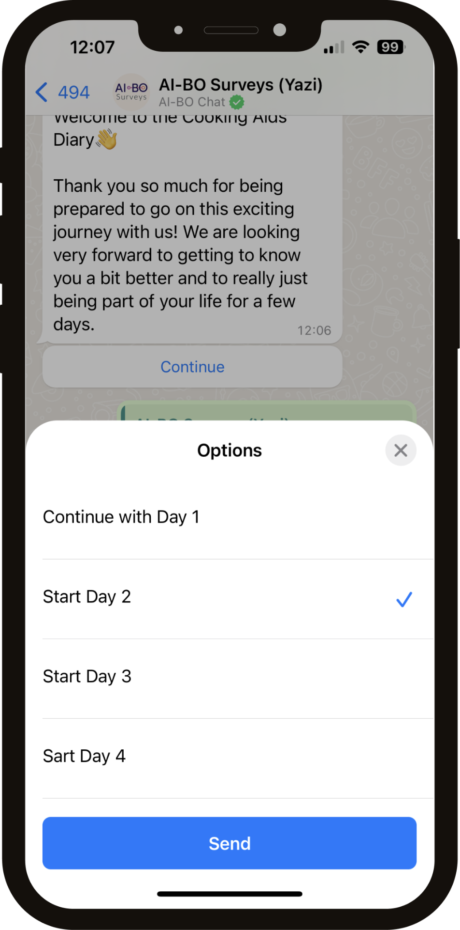
DIARY STUDY · IN THE FIELD
Real moments, in the participant's own words.
• Day-by-day prompts arrive right in the chat they already use
• Photo and video of the moment — shelf, meal, journey, product in use
• Voice notes for the texture that text surveys miss
• Every entry timestamped and threaded across the study
askyazi.com

Slide 12
DIARY STUDY · WHY WHATSAPP
Diary studies fail on drop-off. This one doesn't.
App-based diaries lose participants by day three. WhatsApp is already on the phone, already open — so people keep showing up.
95%+
Multimodal
Daily
SA WhatsApp penetration — no app install, no friction
Text, photo, voice & video entries in 150+ languages
Scheduled prompts sustain engagement across the study
Diary studies fielded for Pick n Pay & a national SA telco (Project Nexa)

Slide 13
CUSTOMER EXPERIENCE
Post-service · Post-purchase · Post-delivery
Customer feedback that lands while it still matters.
Automated WhatsApp surveys fire the moment a service, purchase or delivery completes. Customers reply in under two minutes — and a live dashboard benchmarks every dealer, franchise and location in the network.
askyazi.com

Slide 14
CUSTOMER EXPERIENCE · HOW IT WORKS
Triggered, conversational, benchmarked.
A feedback loop that runs itself across every location.
1
2
3
4
Trigger
Converse
Benchmark
Act
A completed service, sale or delivery fires a WhatsApp survey automatically via CRM/API integration.
The customer replies in under 2 minutes. Adaptive follow-ups dig into the “why” behind every score.
Scores roll up live — every dealer, franchise and region ranked against the network in real time.
Alerts flag detractors and outliers instantly, so teams recover the experience before the customer churns.
NPS · CSI · post-purchase · journey QA · franchise & location benchmarking

Slide 15
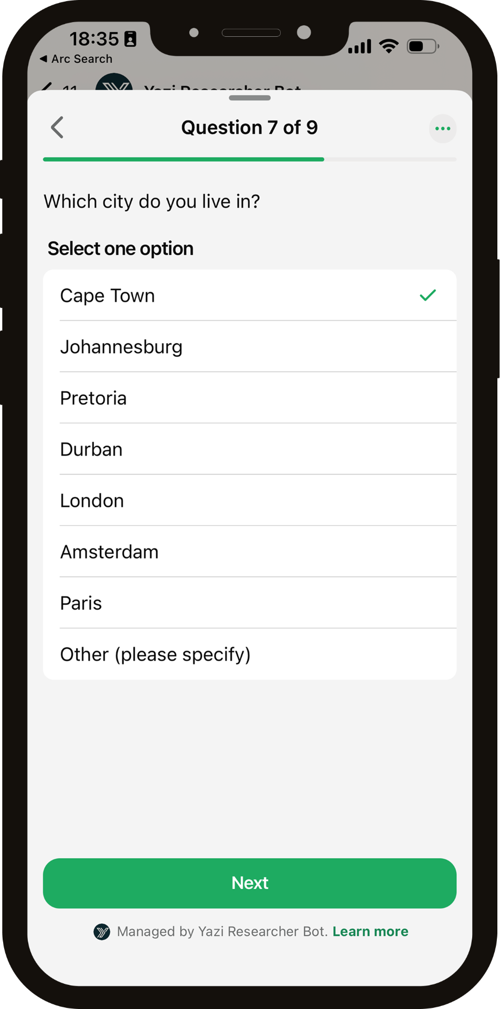
CUSTOMER EXPERIENCE · OUTPUT
One live dashboard. Every location ranked.
• Real-time experience scores for every dealer, franchise or branch
• Regional roll-ups and network benchmarks at a glance
• Detractor alerts and flagged cases for immediate recovery
• Themes and verbatims auto-surfaced from every conversation
askyazi.com

Slide 16
CUSTOMER EXPERIENCE · WHY IT WORKS
The survey customers don't ignore.
Phone-based CSI annoys customers and email gets ignored. A two-minute WhatsApp conversation feels like being looked after — so they actually answer.
68%+
<2 min
Live
Response rate — vs ~3–5% on email and falling phone reach
To complete — replied to in the customer's own time
Network-wide benchmarking, not a report weeks later
Trusted for CX by KFC, Uber, Virgin Active & Old Mutual

