Slide 1

MARKET RESEARCH
WhatsApp-native research
Full-method research on a 1.8M+ panel — quant, qual and everything between.
Brand tracking, concept & pricing tests, ad testing, AI interviews and diary studies. Fielded conversationally over WhatsApp across 20+ countries, in 150+ languages.
askyazi.com

Slide 2

MARKET RESEARCH · HOW IT WORKS
From brief to fielded study in hours, not weeks.
A conversational field method that holds up to agency rigour.
1
2
3
4
Design
Recruit
Field
Analyse
AI-assisted scripting with skip logic, randomisation and adaptive follow-ups. Quant and qual in one flow.
Tap the 1.8M+ panel or upload the client's own database. Verified, profiled respondents across 20+ countries.
Respondents reply in WhatsApp — text, voice or video — in 150+ languages with live translation. PII auto-masked.
Real-time themes, cross-tabs and AI summaries. Export clean data straight into your reporting.
Van Westendorp · Gabor-Granger · concept & ad testing · brand tracking · AI interviews

Slide 3
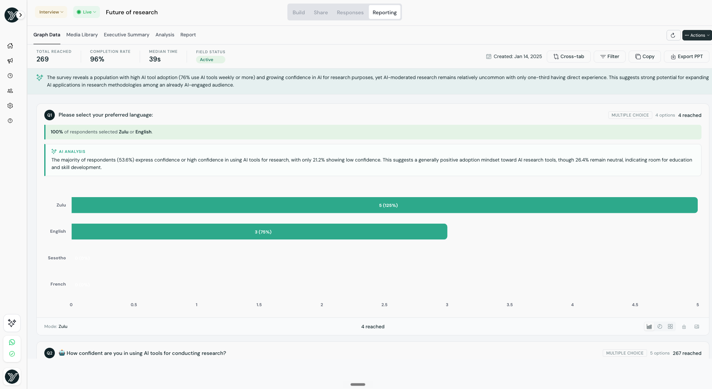
MARKET RESEARCH · OUTPUT
Live analytics, exportable to PowerPoint.
• Real-time completion, reach and median-time tracking as the study fields
• Interactive bar charts with filtering and cross-tab capabilities
• AI analysis surfaces the “so what” on every question
• One-click export straight to PowerPoint or your stats package
askyazi.com

Slide 4
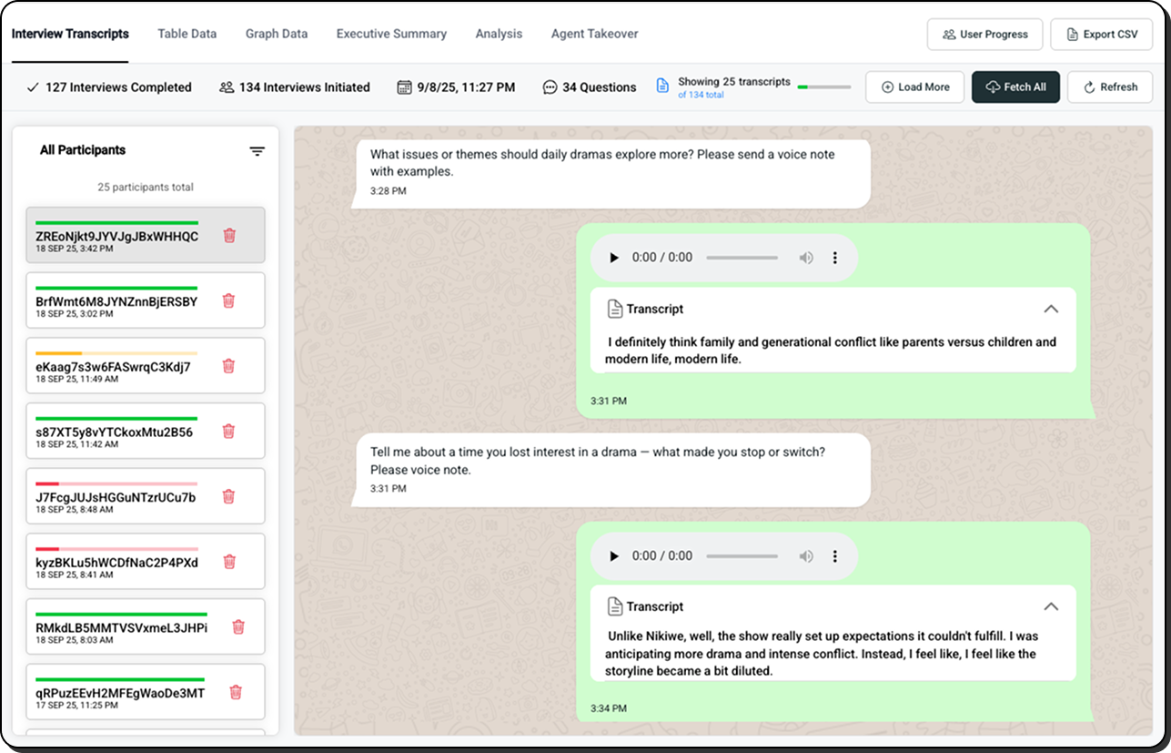
MARKET RESEARCH · QUALITATIVE
Qual depth, at survey-level scale.
• Immersive chat view — transcripts plus voice & video, with image meta-text
• Media gallery — browse and download every rich-media response
• Agent takeover — step in as a human moderator to probe in real time
• AI threads themes across every participant, in 150+ languages
askyazi.com

Slide 5
MARKET RESEARCH · WHY WHATSAPP
A better field method, on the numbers.
Metric | Traditional (email / phone / panel) | WhatsApp via Yazi
Response rate | ~3–5% | 68%+
Time to complete | 3–5 days | < 2 hours
Cost per complete | $15–25 | $0.50
Data depth | Fixed-form, text only | Text · voice · video, 150+ languages
Featured in News24, TimesLive & Mail & Guardian — Yazi SA Fuel & Energy Sentiment Study, 2026

