Slide 1

CONVERSATIONAL RESEARCH · POWERED BY WHATSAPP
WHAT IS YAZI
Research and customer feedback that people actually reply to — over WhatsApp.
Yazi runs surveys, AI interviews and diary studies inside WhatsApp, on a panel of 1.8M+ pre-qualified respondents across 20+ countries. Conversational, multilingual, and live in hours — not weeks.
askyazi.com

Slide 2






WHY IT WORKS
WhatsApp delivery beats every other channel.
68%+
<2 hrs
$0.50
150+
Response rate — ~5× higher than email
Average time to complete vs 3–5 days
Cost per complete vs $15–25 traditional
Languages with built-in translation
Trusted by KFC, Uber, Ipsos, Harvard Business School, Discovery & more

Slide 3
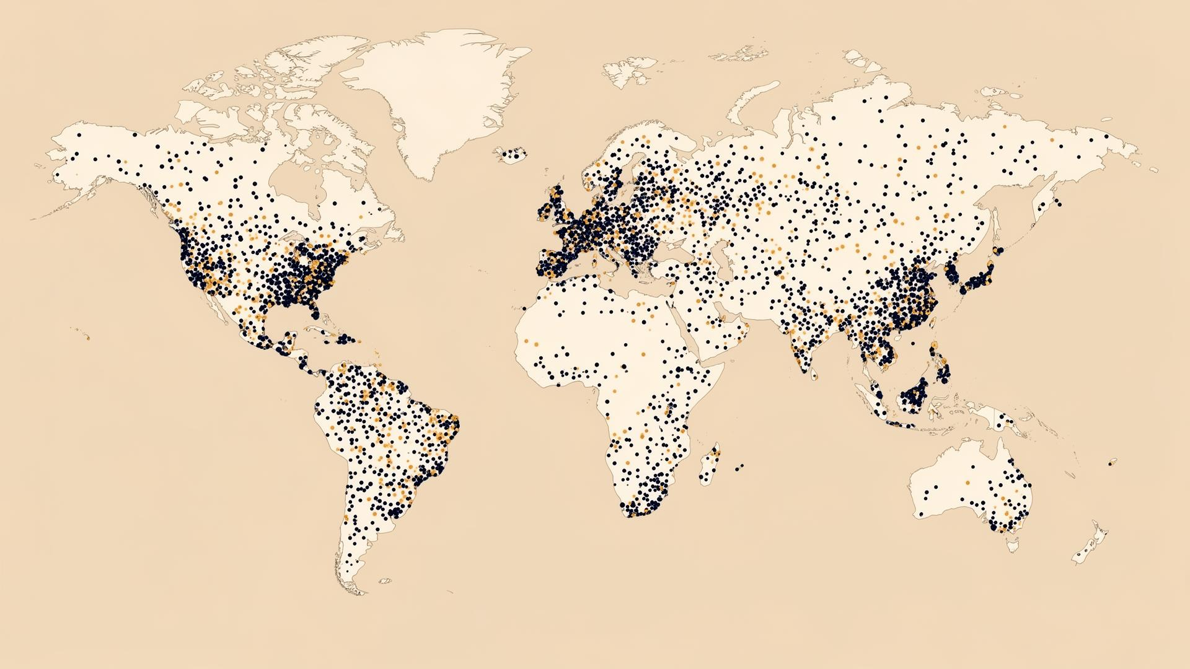
REACH & RECRUITMENT
A 1.8M+ panel, or your own database.
• 1.8M+ pre-qualified respondents across 20+ countries
• Partner network — Cint, Prolific, Respondent IO — reaching 50+ countries
• Or upload the client's own customer lists via CRM/API
• Profiled, verified, recruited at a fraction of traditional cost
askyazi.com

