Slide 1

DIARY STUDY
Longitudinal · In-the-moment
Capture behaviour as it happens — over days, not in hindsight.
Scheduled WhatsApp prompts collect text, photo, voice and video entries in the moment, over the life of the study. The richness of a diary study, without the drop-off of an app.
askyazi.com

Slide 2

DIARY STUDY · HOW IT WORKS
A study that unfolds over time.
Sequenced prompts keep participants engaged from day one to wrap-up.
1
2
3
4
Recruit & onboard
Sequence
Capture
Synthesise
Enrol from the 1.8M+ panel or the client's customers. Participants opt in inside WhatsApp — no app to download.
Scheduled prompts fire daily or at set moments — morning, post-purchase, end of week — across the study window.
Entries come back as text, photo, voice or video, in the moment, in 150+ languages with live translation.
AI threads each participant's journey, codes themes over time, and surfaces shifts in behaviour and sentiment.
Shopper journeys · usage & occasion · ethnographic · longitudinal brand & behaviour tracking

Slide 3
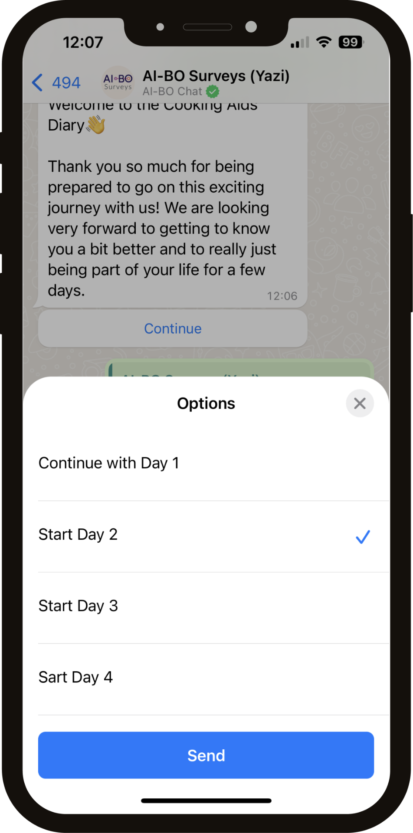
DIARY STUDY · IN THE FIELD
Real moments, in the participant's own words.
• Day-by-day prompts arrive right in the chat they already use
• Photo and video of the moment — shelf, meal, journey, product in use
• Voice notes for the texture that text surveys miss
• Every entry timestamped and threaded across the study
askyazi.com

Slide 4
DIARY STUDY · WHY WHATSAPP
Diary studies fail on drop-off. This one doesn't.
App-based diaries lose participants by day three. WhatsApp is already on the phone, already open — so people keep showing up.
95%+
Multimodal
Daily
SA WhatsApp penetration — no app install, no friction
Text, photo, voice & video entries in 150+ languages
Scheduled prompts sustain engagement across the study
Diary studies fielded for Pick n Pay & a national SA telco (Project Nexa)

