Slide 1

CUSTOMER EXPERIENCE
Post-service · Post-purchase · Post-delivery
Customer feedback that lands while it still matters.
Automated WhatsApp surveys fire the moment a service, purchase or delivery completes. Customers reply in under two minutes — and a live dashboard benchmarks every dealer, franchise and location in the network.
askyazi.com

Slide 2

CUSTOMER EXPERIENCE · HOW IT WORKS
Triggered, conversational, benchmarked.
A feedback loop that runs itself across every location.
1
2
3
4
Trigger
Converse
Benchmark
Act
A completed service, sale or delivery fires a WhatsApp survey automatically via CRM/API integration.
The customer replies in under 2 minutes. Adaptive follow-ups dig into the “why” behind every score.
Scores roll up live — every dealer, franchise and region ranked against the network in real time.
Alerts flag detractors and outliers instantly, so teams recover the experience before the customer churns.
NPS · CSI · post-purchase · journey QA · franchise & location benchmarking

Slide 3
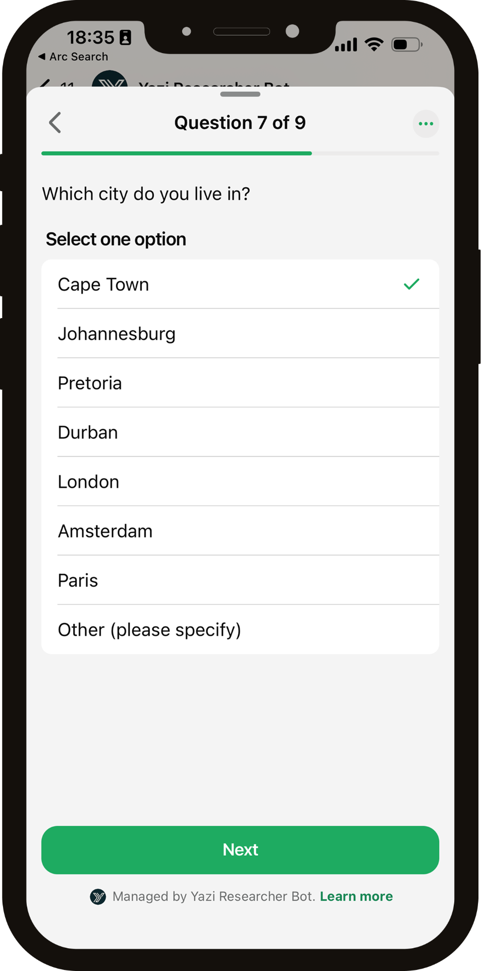
CUSTOMER EXPERIENCE · OUTPUT
One live dashboard. Every location ranked.
• Real-time experience scores for every dealer, franchise or branch
• Regional roll-ups and network benchmarks at a glance
• Detractor alerts and flagged cases for immediate recovery
• Themes and verbatims auto-surfaced from every conversation
askyazi.com

Slide 4
CUSTOMER EXPERIENCE · WHY IT WORKS
The survey customers don't ignore.
Phone-based CSI annoys customers and email gets ignored. A two-minute WhatsApp conversation feels like being looked after — so they actually answer.
68%+
<2 min
Live
Response rate — vs ~3–5% on email and falling phone reach
To complete — replied to in the customer's own time
Network-wide benchmarking, not a report weeks later
Trusted for CX by KFC, Uber, Virgin Active & Old Mutual

